Slide 1
CORROSION PREVENTION BY NANOTECHNOLOGY
PRESENTEND BY:
M.Tabassum & K.Lahari
Department of CSE &ECE

Slide 2

Keywords:
Corrosion
Nanocoating
Metallic nanocoating

Slide 3
Introduction:
Corrosion is one of the major research areas that has been attracting the attention of researchers for over 150 years,
since it is recognized as a problem causing degradation, failure,
and serious accidents and hazards in many industrial processes and domestic systems .

Slide 4
Corrosion is the deterioration of the metals due to their reaction with a corrosive element in their surroundings, such as chlorine,
fluorine, carbon dioxide, oxygen, etc. Damages due to corrosion in terms of economic aspects include repair and maintenance costs, loss of materials, damage to equipment, a decrease in efficiency, and loss of useful or productive life.

Slide 5
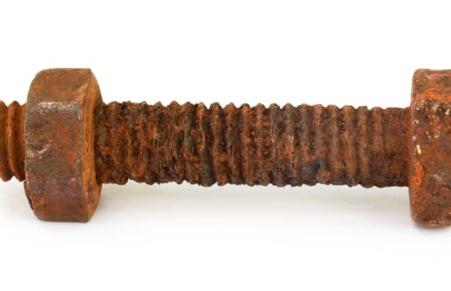
CORROSION EFFECT ON BOLTS

Slide 6
Nanocoating and its prevention in corrosion
A nanocoating is an ultrafine microstructure where all of the constituents (boundaries, crystals, phases, etc.) are on the scale of less than 100 nm.
These coatings can also be built up by layers that are thinner than 100 nm .

Slide 7
They have a high density of grain boundaries, interphone boundaries, dislocations etc., where the spacing between them approaches interatomic distances.
Therefore, nanostructured coatings exhibit different properties from the larger-grained, conventional coatings, which enabled them to overcome the mechanical and corrosion properties of their counterparts.
Nanocoatings can be classified according to the constituent materials, such as metallic coating

Slide 8
Metallic nanocoating:
Metallic nanocoating includes one or more of the pure metals such as Cadmium (Cd), Nickel(Ni),Tungsten(W),Zinc(Zn),Phosphorous(P),Cobalt(Co),Iron(Fe),Copper(Cu),etc.
Metallic nanocoatings are can be produced through more than one technique such as sputtering and multi arc icon plating.

Slide 9

NANOTECHNOLOGY IN NATURE

Slide 10


Slide 11


Slide 12


